Slide 1
How Entrepreneurial Cultures Spur Entrepreneurial Action Connecting Universities to Economic Development UNC Charlotte ADVANCE Bridging the Gap Conference March 19, 2013 Ken Harrington

Slide 2
What is the Gap?
Notes:
Women, Minorities, Organizations, stage of maturity, investors vs. entrepreneurs, approach (Blank, pivoting, planning?)
Do you know what each other are doing?

Slide 3
What is Your Motivation?
Notes:
Women, Minorities, Organizations, stage of maturity, investors vs. entrepreneurs, approach (Blank, pivoting, planning?)

Slide 4
What is Your Region’s Current State?
Notes:
Lots going on. Frequency of interactions? Entrepreneurs or top down?

Slide 5
What is Culture?
Notes:
Do you have one at this point? Is it getting stronger? How fast? How many years?

Slide 6
Two Perspectives
Pick winners-Ventures & Inputs(Eco Devo)
Energize people-Social Connections & Relationships (Culture)
Notes:
“and” not or. How get together without slowing down?

Slide 7
Economic Development
Resource and Infrastructure Inputs
Research as an input
Infrastructure
Capital
Economic Outcomes
Ventures
Investment
Jobs
Notes:
Clusters, High opportunity, Top down, History

Slide 8
Culture Development
Culture Inputs
Collaboration events
Relationships
Institutions, especially technology transfer
Culture Outputs
Ideas
Entrepreneurs
Learning curve
Notes:
Interest areas, Entrepreneurs’ personal motivations, Bottom up, New
Interestingly, the two often argue about who is right

Slide 9
Charlotte’s Approach?
Notes:
Do you have one at this point? Is it getting stronger? How fast? How many years? Once again, do you know what the other guy is doing?

Slide 10
Interest Areas?
Information Technology
Bioscience
Social Entrepreneurship
Energy & Environment
Financial Services
Healthcare Services
Design and Art
Food
Notes:
How many have an entrepreneur champion? What events to accelerate relationships? Efforts that encourage ideas and connect the entrepreneurs? Support systems that develop early stage, first time entrepreneurs?

Slide 11
Culture
Entrepreneurs are the source
Without entrepreneurs not sustainable
Getting better every week
Never done, just better
Collaboration

Slide 12
Entrepreneur Development
.
Entrepreneurial self-efficacy
Perceived need for new outcome
Have idea for start-up
Entrepreneurial expectancy
Entrepreneurial desirability
Entrepreneurial intent
William A. Lucas—MIT
Kenneth A. Harrington Modifications
Notes:
First timers can be invited to play. As the get better and smarter capital will flow. They will always say they are short capital, but they will tell you what else is needed if you ask and engage them.

Slide 13
Community Ecosystem Survey
Economic and Social Factors
Important? Adequate?
Stakeholder groups
Open and transparent
Discuss priorities and goals
Notes:
I think this is valuable as it promotes dialog and collaboration.

Slide 14
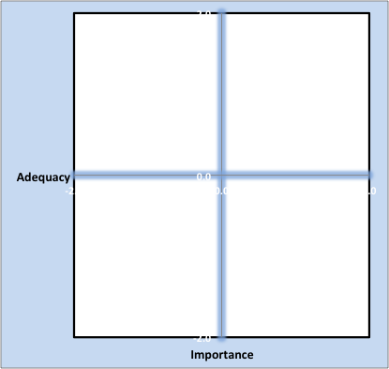
Ecosystem Statuses
Controlled
Euphoric
Apathetic
Aspirational
Notes:
Controlled=bureaucratic; Apathetic=lack of understanding or collaboration; Aspirational=good potential for improvement. Resource priority conflicts. Need collaboration. Euphoric=Northern CA but can lose momentum (are people and $ moving in or moving out?)

Slide 15
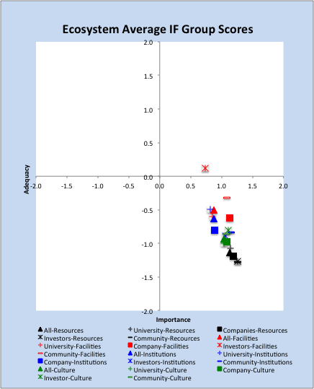
Notes:
Example=St. Louis

Slide 16
Roles in the Ecosystem?
University role?
Champion role?
Entrepreneur role?
Economic development role?
Service provider role?
Government role?
Industry role?

Slide 17
What Stage of Maturity?
Phase 0-Research, Invention
Phase 1-Idea & Entrepreneur Development
Phase 2-Team and Venture Launch
Phase 3-Venture Affirmation
Phase 4-Company Growth
Phase 5-Exit and Restart

Slide 18
Collaboration Causes Culture
Economic Development
Culture Development
Interest Areas
Entrepreneurs first, not ventures
Patience

