Slide 1
College of Education
Scorecard

Slide 2
Data used for this Diversity Scorecard
ADVANCE FADO used the
  2018 Institutional Research Data
  2018 Collaborative on Academic Careers in Higher Education (COACHE) data

Slide 3
Overall Faculty Rank by Race & Sex
at UNC Charlotte
White
Non – White
% of Faculty
Non-White: American Indian or Alaska Native, Non-Hispanic Asian,
Non-Hispanic Black, Hispanic, Nat Hawaiian/Other Pacific Islander,
Two or More Races, Unknown
Male
Female

Slide 4
Overall Faculty Rank by Race & Sex
College of Education - Fall 2018
White
Non – White
% of Faculty
Non-White: American Indian or Alaska Native, Non-Hispanic Asian,
Non-Hispanic Black, Hispanic, Nat Hawaiian/Other Pacific Islander,
Two or More Races, Unknown
Male
Female

Slide 5

Student Demographics by Race/Ethnicity
College of Education - Fall 2018
Percentage of Students

Slide 6
Student Demographics by Sex
College of Education - Fall 2018
Percentage of students

Slide 7
Climate Data (From COACHE Survey)

Slide 8
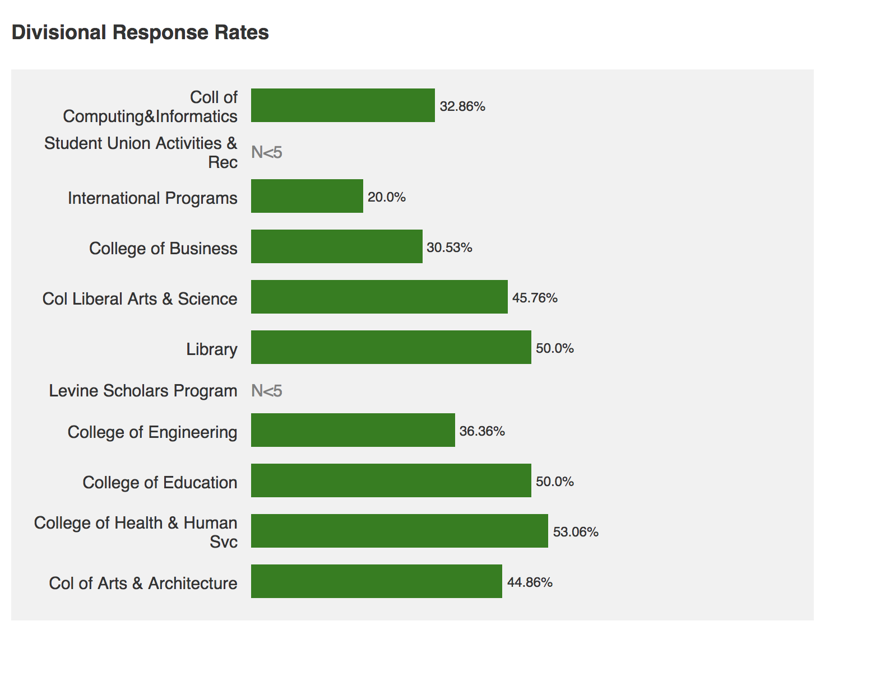

Slide 9
Summary of Benchmarks: ALL FACULTY
Areas of highest satisfaction:
  Facilities and Work Resources, Mentoring
Areas of lowest satisfaction:
  Health and Retirement Benefits, Nature of Work - Teaching
Improved since last survey:
  Majority of benchmarks have improved
Worsened since last survey:
  Leadership:
    Senior
    Faculty
  Governance
    Shared sense of purpose
    Understanding the issue at hand
    Productivity

Slide 10
Summary of Benchmarks: CHHS
Areas of highest satisfaction:
  Facilities and Work Resources, Teaching, Tenure Policies and Dept. Collegiality
Areas of lowest satisfaction:
  Interdisciplinary work; Promotion to Full; Governance
Areas lower than other Colleges:
  Interdisciplinary work; Promotion to Full and Dept. Quality
  Items in green are different from ALL Faculty Data

Slide 11
Divisional Analysis - College of Education

Slide 12
Summary of Benchmarks Specific to the College of Education
Areas of Strength:
  Nature of work: Research –quality of grad students to support research
  Nature of work: Service – Time spent on service, support for faculty in leadership roles
  Nature of work: Teaching – quality of grad students to support teaching
Areas of Concern:
  Support for securing grad student assistance, support for travel to present/conduct research, availability of course release for research,
  Number of committees, equitability of committee assignments
  Time spent on teaching, number of courses taught, level of courses taught, discretion over course content, equitability of distribution of teaching load
  Time spent on administrative tasks

