Slide 1
College of Business
Scorecard

Slide 2
Data used for this Diversity Scorecard
ADVANCE FADO used the
  2018 Institutional Research Data
  2018 Collaborative on Academic Careers in Higher Education (COACHE) data

Slide 3
Overall Faculty Rank by Race & Sex
at UNC Charlotte
White
Non – White
% of Faculty
Non-White: American Indian or Alaska Native, Non-Hispanic Asian,
Non-Hispanic Black, Hispanic, Nat Hawaiian/Other Pacific Islander,
Two or More Races, Unknown
Male
Female

Slide 4
Overall Faculty Rank by Race & Sex
College of Business- Fall 2018
White
Non – White
% of Faculty
Non-White: American Indian or Alaska Native, Non-Hispanic Asian,
Non-Hispanic Black, Hispanic, Nat Hawaiian/Other Pacific Islander,
Two or More Races, Unknown
Male
Female

Slide 5

Student Demographics by Race/Ethnicity
College of Business - Fall 2018
Percentage of Students

Slide 6
Student Demographics by Sex
College of Business - Fall 2018
Percentage of students

Slide 7
Climate Data (From COACHE Survey)

Slide 8
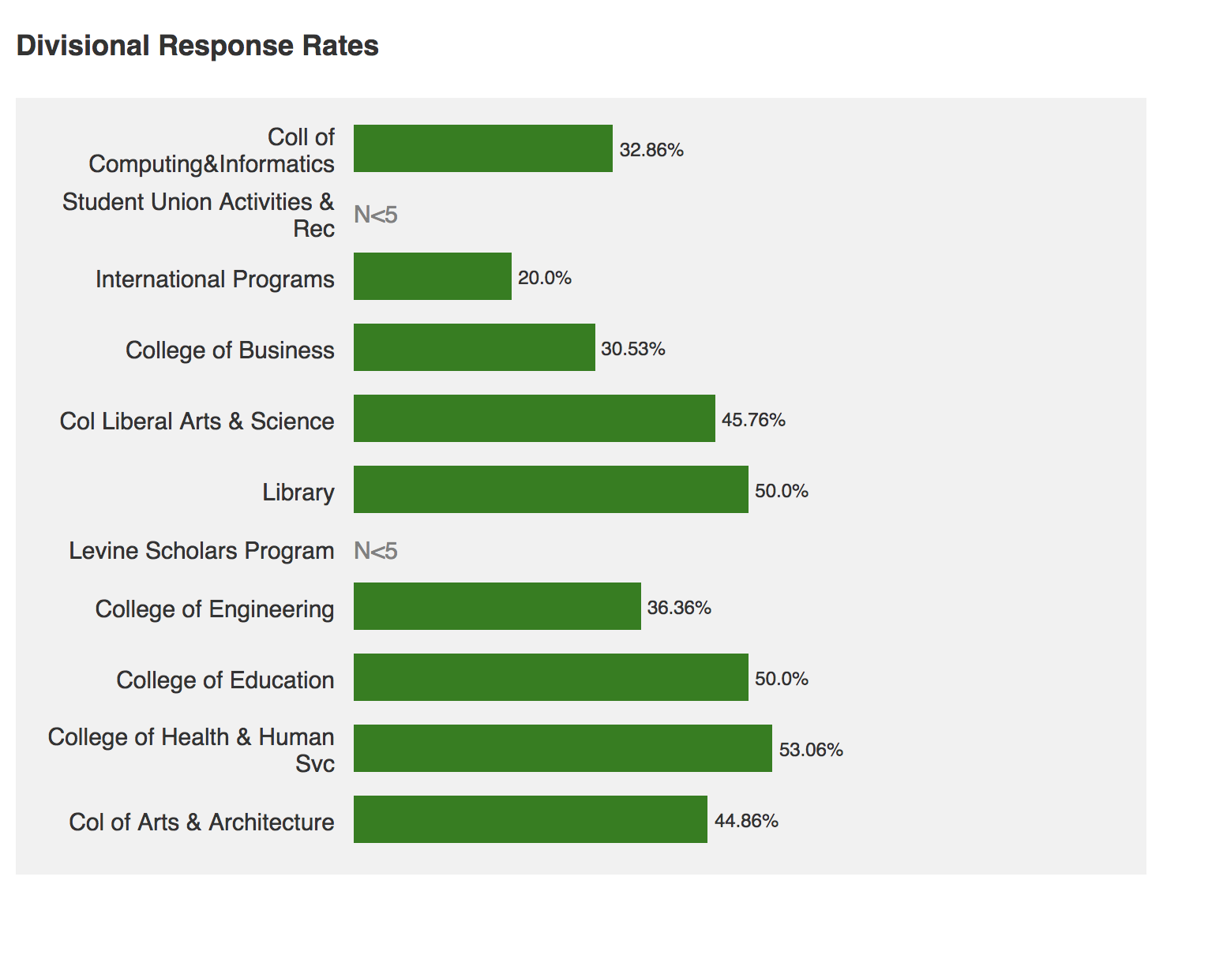

Slide 9
Summary of Benchmarks: ALL FACULTY
Areas of highest satisfaction:
  Facilities and Work Resources, Mentoring
Areas of lowest satisfaction:
  Health and Retirement Benefits, Nature of Work - Teaching
Improved since last survey:
  Majority of benchmarks have improved
Worsened since last survey:
  Leadership:
    Senior
    Faculty
  Governance
    Shared sense of purpose
    Understanding the issue at hand
    Productivity

Slide 10
Summary of Benchmarks: CHHS
Areas of highest satisfaction:
  Facilities and Work Resources, Teaching, Tenure Policies and Dept. Collegiality
Areas of lowest satisfaction:
  Interdisciplinary work; Promotion to Full; Governance
Areas lower than other Colleges:
  Interdisciplinary work; Promotion to Full and Dept. Quality
  Items in green are different from ALL Faculty Data

Slide 11
Divisional Analysis - College of Business

Slide 12
Summary of Benchmarks Specific to Business
Areas of Strength:
  Nature of work: Research – most items
  Nature of work: Service – Time spent on Service and equitability of committee assignments
  Nature of work: Teaching – Quality of graduate students to support teaching
  Time spent on outreach
Areas of lowest satisfaction:
  Influence over focus of research
  Support for faculty in leadership roles
  Most items in Nature of Work: Teaching (except the one identified as a strength)

