Slide 1
College of Computing & Informatics
Scorecard

Slide 2
Data used for this Diversity Scorecard
ADVANCE FADO used the
  2018 Institutional Research Data
  2018 Collaborative on Academic Careers in Higher Education (COACHE) data

Slide 3
Overall Faculty Rank by Race & Sex
at UNC Charlotte
White
Non – White
% of Faculty
Non-White: American Indian or Alaska Native, Non-Hispanic Asian,
Non-Hispanic Black, Hispanic, Nat Hawaiian/Other Pacific Islander,
Two or More Races, Unknown
Male
Female

Slide 4
Overall Faculty Rank by Race & Sex
College of Computing & Informatics - Fall 2018
White
Non – White
% of Faculty
Non-White: American Indian or Alaska Native, Non-Hispanic Asian,
Non-Hispanic Black, Hispanic, Nat Hawaiian/Other Pacific Islander,
Two or More Races, Unknown
Male
Female

Slide 5

Student Demographics by Race/Ethnicity
College of Computing & Informatics - Fall 2018
Percentage of Students

Slide 6
Student Demographics by Sex
College of Computing & Informatics - Fall 2018
Percentage of students

Slide 7
Climate Data (From COACHE Survey)

Slide 8
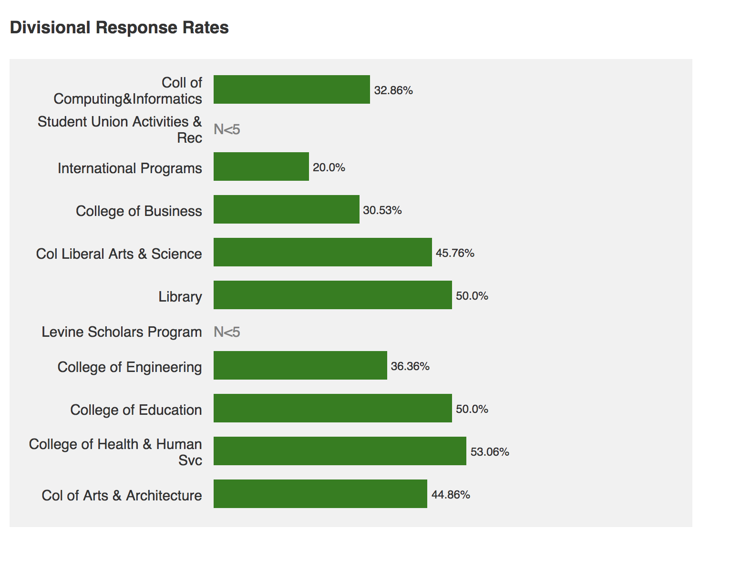

Slide 9
Summary of Benchmarks: ALL FACULTY
Areas of highest satisfaction:
  Facilities and Work Resources, Mentoring
Areas of lowest satisfaction:
  Health and Retirement Benefits, Nature of Work - Teaching
Improved since last survey:
  Majority of benchmarks have improved
Worsened since last survey:
  Leadership:
    Senior
    Faculty
  Governance
    Shared sense of purpose
    Understanding the issue at hand
    Productivity

Slide 10
Summary of Benchmarks: CHHS
Areas of highest satisfaction:
  Facilities and Work Resources, Teaching, Tenure Policies and Dept. Collegiality
Areas of lowest satisfaction:
  Interdisciplinary work; Promotion to Full; Governance
Areas lower than other Colleges:
  Interdisciplinary work; Promotion to Full and Dept. Quality
  Items in green are different from ALL Faculty Data

Slide 11
Divisional Analysis - College of Computing & Informatics

Slide 12
Summary of Benchmarks by Demographics
Further summaries can not be done for the COACHE data for this college because the departments do not fall under one specific COACHE heading.
As analysis of the data is done in house, more information will be added.

